Slide 1
Order of convergence - Basics

Slide 2
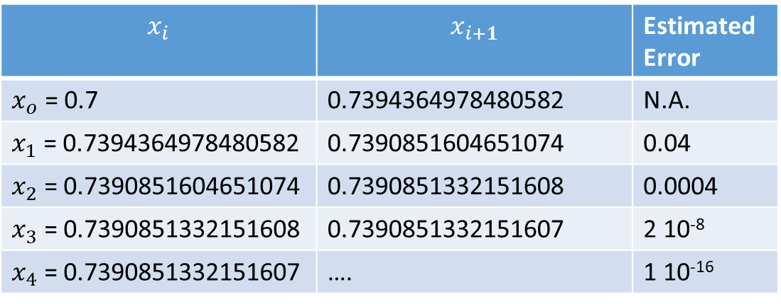
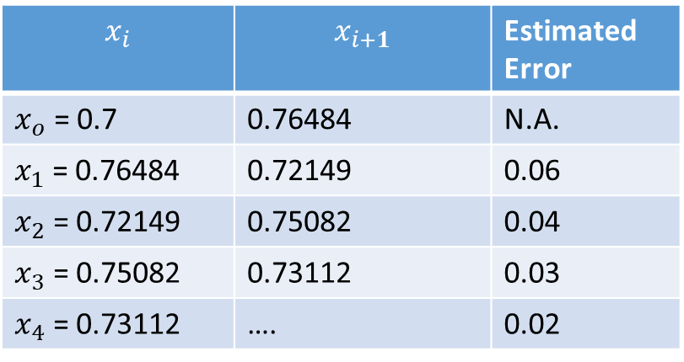


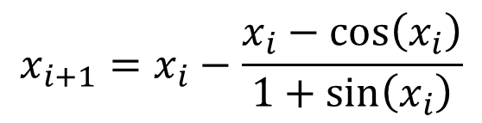
How fast is an algorithm?
$$x=cos⁡(x)$$
Fixed Point Method
Newton’s Method
$$x_{i+1}=x_{i}−\frac{x_{i}−cos⁡\left(x_{i}\right)}{1+sin⁡\left(x_{i}\right)}$$
$$x_{i+1}=cos⁡\left(x_{i}\right)$$
$$x_{i}$$ | $$x_{i+1}$$ | Estimated Error
$x_{o}$ = 0.7 | 0.76484 | N.A.
$x_{1}$ = 0.76484 | 0.72149 | 0.06
$x_{2}$ = 0.72149 | 0.75082 | 0.04
$x_{3}$ = 0.75082 | 0.73112 | 0.03
$x_{4}$ = 0.73112 | …. | 0.02
$$x_{i}$$ | $$x_{i+1}$$ | Estimated Error
$x_{o}$ = 0.7 | 0.7394364978480582 | N.A.
$x_{1}$ = 0.7394364978480582 | 0.7390851604651074 | 0.04
$x_{2}$ = 0.7390851604651074 | 0.7390851332151608 | 0.0004
$x_{3}$ = 0.7390851332151608 | 0.7390851332151607 | 2 10⁻⁸
$x_{4}$ = 0.7390851332151607 | …. | 1 10⁻¹⁶
Notes:
In this lecture we are going to discuss how we can compare the speed of different algorithms.
More precisely we want to compare how fast, or how slow, they are able to compute an approximation of a solution of an equation with a given tolerance.
Let us start with an example.
Consider the equation x = cos(x).
In previous lectures we solved this equation numerically.
We computed approximations of the solution using the fix point iteration method.
We computed as well approximations using Newton’s method.
Both methods solve the same equation. But as you note by comparing both tables we don’t get the same precision in the same number of iterations.
For the fixed point iteration we get an approximation wit an error of about 0.02 after four iterations.
Newton’s method, after the same number of iterations, was able to give an approximation with an error of 10 to -16.
This is a much lower error.
This example teaches us that different algorithms when solving numerically a same equation and starting with a same initial guess, can give very different quality of results in the same number of iterations.

Slide 3


Comparing the speed of convergence of algorithms
High Error
Error $E_{i}$
Algorithm 1
Low Error
Algorithm 2
Number of iterations $i$
Notes:
A better way to compare the results of the calculations of two algorithms is to use the so-called error plot.
The error plot is showing the error $E_{i}$ of the approximation $x_{i}$ in function of the number $i$ of the iteration.
On the example shown here, Algorithm 2 gives, for a same number of iterations, approximations with a smaller error than Algorithm 1.
We say that Algorithm 2 is faster than Algorithm 1.

Slide 4

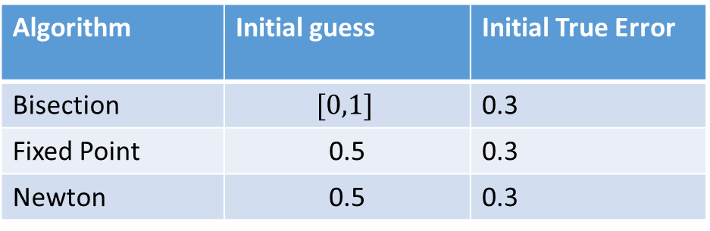
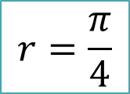
Test Equation
$$cos⁡(x)=sin⁡(x)$$
$$r=\frac{π}{4}$$
Algorithm | Initial guess | Initial True Error
Bisection | $$[0,1]$$ | 0.3
Fixed Point | 0.5 | 0.3
Newton | 0.5 | 0.3
Notes:
Let us now compare the algorithms we learned so far on a same equation.
For this we choose an equation from which we know the root.
The equation we consider is cos(x) = sin(x). A solution r of this equation is pi over four.
We will compare the performance of the bisection, fixed point and Newton algorithm
To be fair, we start all algorithms with an initial guess having a same true error.
For the bisection algorithm we start with the interval [0, 1]. This gives an initial approximation xo of 0.5.
We use this same initial approximation 0.5 for the two other algorithms.
The initial error of all three algorithms is 0.5 minus pi/4, which is about 0.3.

Slide 5
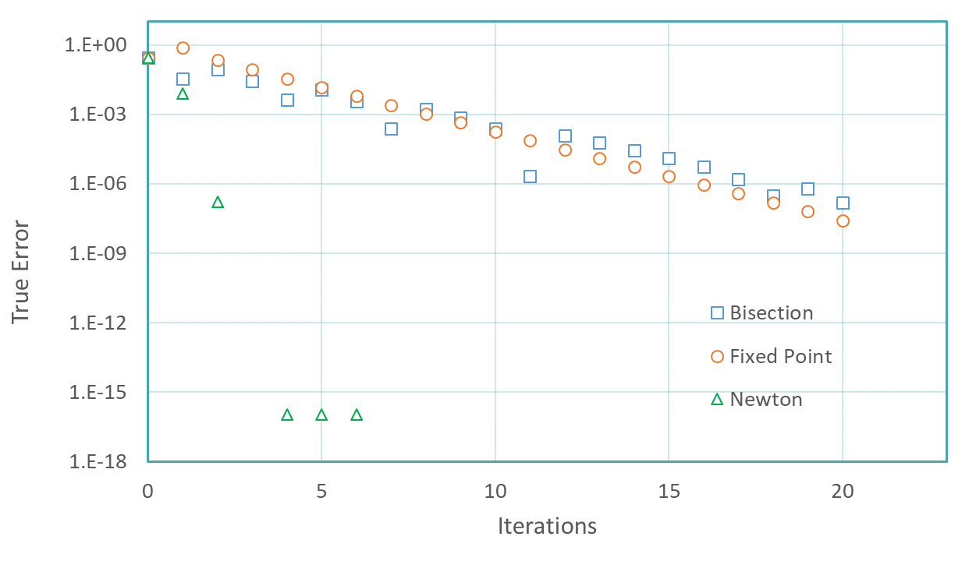
Error no longer drops
Notes:
If you plot the true error in function of the number of iterations for the three algorithms you should obtain a figure similar to the one displayed.
I invite you, once you have finished listening to this lecture, to try to reproduce these three curves using the octave scripts you have produced in the previous lectures.
For the moment just focus on the conclusions we can draw from this figure.
Comparing the three algorithms, we can observe that the bisection and the fixed point iteration methods, the circles and squares, converge with about similar speeds.
The fixed point method, the circles, converges slightly faster, but the difference is insignificant.
Newton’s method, the triangles, converges much faster. Already after a few iterations the error drops as low as 10 to -16.
Another striking and interesting effect is that the error remains constant once it reached around 10 to -16.
What is the reason?
In our calculations we used octave. Octave uses 16 significant digits. Once the error drops to 10 to -16, it can no longer drop further. We reached the best possible calculations we can achieve with 16 significant digits.
This comes from the round-off errors.
In future we are going to discuss in more details this behavior.
But let us already mention that it is a very typical effect.
At first, as the algorithm is used with increasing number of iterations, the error drops because the algorithm is designed to bring down the truncation error.
Recall that the truncation error is the error coming from the fact we use an approximation to solve our mathematical problem.
Any well designed algorithm becomes more and more accurate as we proceed with more iterations.
The algorithm converges to the true solution of the mathematical problem.
This means that the truncation error reduces.
But as we iterate more and more, round-off errors become more important. And even if the algorithm keeps reducing the truncation error, the total error will increase because of round-off errors.
In fact, for a given number of significant digits used in the calculations, there is a smallest possible error one can reach.

Slide 6
Quantification of the speed of convergence
Plotting the error versus the number of iteration allows us to compare two algorithms in term of speed of convergence
The following definition gives a quantitative measure
Notes:
So far we learned that we can compare the speed of convergence between algorithms by plotting the error in function of the number of iterations.
Graphs are excellent tools to visualize behaviors. But sometimes one would like to use a more quantitative way.
In numerical analysis, mathematicians have developed a quantitative measure for the speed of convergence.
The following definition gives us this quantitative measure.

Slide 7

Order of convergence
Definition
Let$\left\{x_{n}\right\}$ be a series converging to the number $r$. Define $E_{i}=\left|x_{i}−r\right|$.
If there exist positive constants λ and α such that
then $\left\{x_{n}\right\}$ is said to converge to $r$ with order α and asymptotic error constant λ.
Notes:
Consider a numerical series xn converging to the number r.
In the context of numerical algorithms, the series is actually an algorithm, for example Newton’s algorithm.
Define now ei as the difference between xi and r.
In the context of numerical analysis the quantity ei is the true error between the root r and the approximation xi produced by the algorithm.
We say that the series xn is converging to r with order αλπηα and asymptotic error constant lambda, if the limit written on the slide exists.
This definition seems at first sight a little abstract and non intuitive.
Let us have a slightly different look to this definition in order to understand it better.

Slide 8
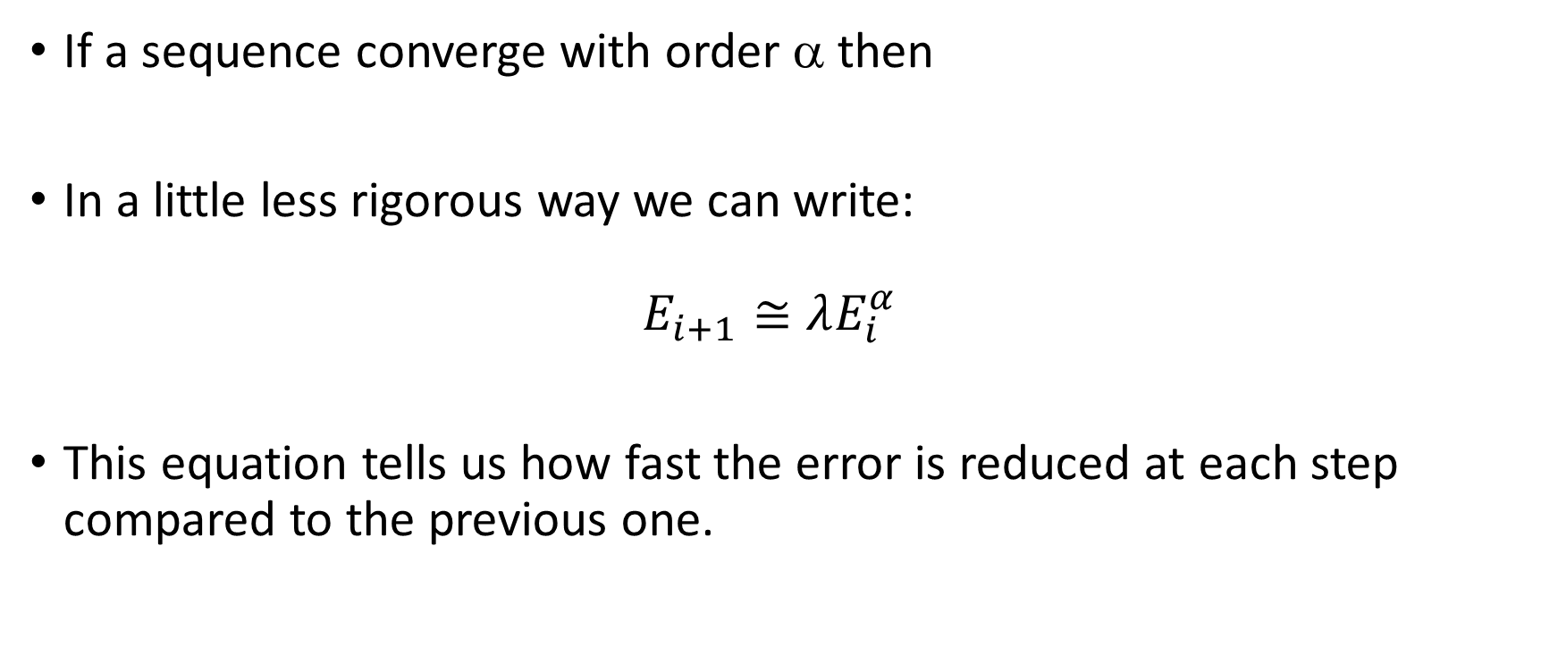
What does this mean?
If a sequence converge with order α then
In a little less rigorous way we can write: $E_{i+1}≅λE_{i}^{α}$
This equation tells us how fast the error is reduced at each step compared to the previous one.
Notes:
The definition of the order of convergence of a series says that the series converge with order alpha if the limit ei+1 divided by ei^alpha exists.
Let us write this rigorous condition in a more intuitive way.
We can write that ei+1 is approximatively equal to lambda times ei to the power alpha.
What does this equation tell us?
This equation states that the error in iteration i+1 can be calculated based on the error of the previous iteration i.
In fact, as for good algorithms the error should be small numbers, it shows how in each iteration the error is reduced further.

Slide 9
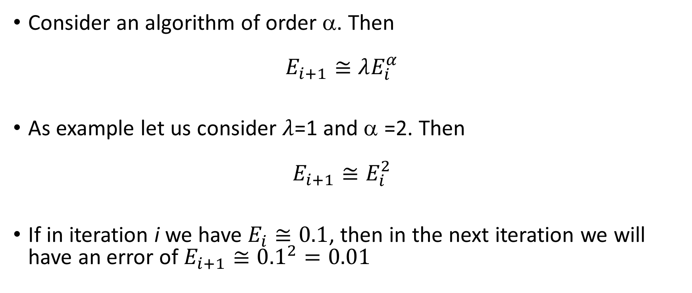
Example
Consider an algorithm of order α. Then $E_{i+1}≅λE_{i}^{α}$
As example let us consider $λ$=1 and α =2. Then $E_{i+1}≅E_{i}^{2}$
If in iteration i we have $E_{i}≅0.1$, then in the next iteration we will have an error of $E_{i+1}≅{0.1}^{2}=0.01$
Notes:
Let us illustrate this finding with an example.
We know how, for an algorithm of order alpha the errors between iterations i and i+1 relates approximatively.
As example let us consider an algorithm of second order and an error constant lambda of one.
In this case we have that ei+1 is approximatively equal to ei to the power 2.
If, for example, in iteration i the error is 0.1, then in the next iteration the error will be approximatively 0.1 squared which is 0.01.
This example shows us that if we know the order alpha and error constant lambda, we can predict how much the error in the coming iteration will be.
Observe that in fact the value of lambda is not very important. What really has an effect on the error reduction is the value of alpha.
It turns out that alpha is a characteristic number of given algorithms. This means each algorithm has a given order of convergence which is independent of the equation we want to solve.

Slide 10
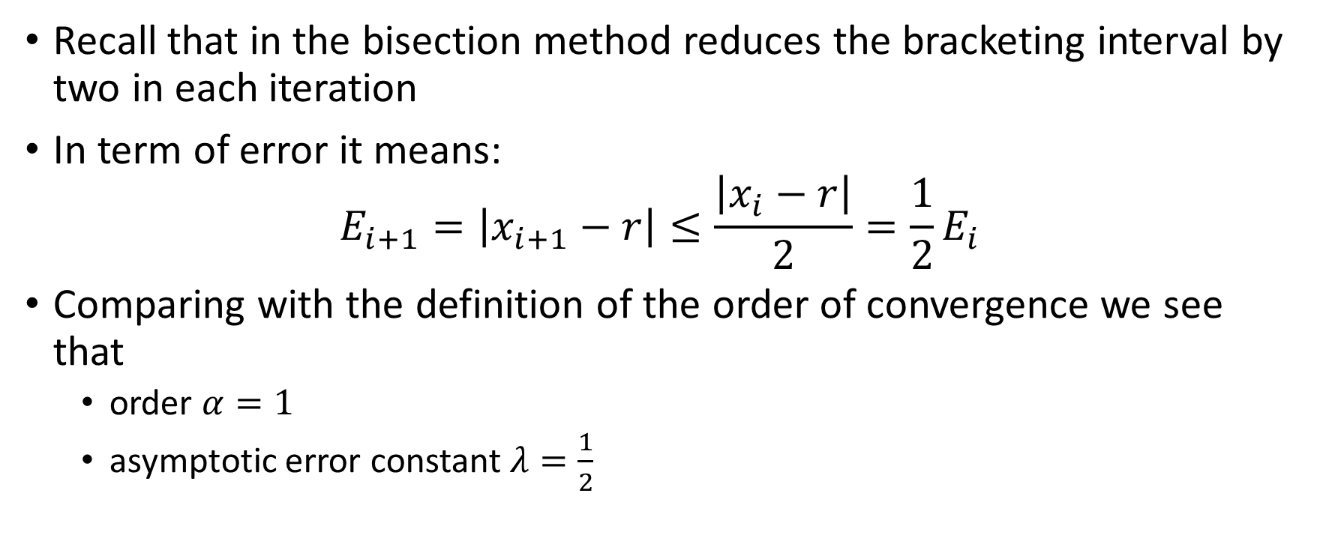
Application : Bisection method
Recall that in the bisection method reduces the bracketing interval by two in each iteration
In term of error it means: $E_{i+1}=\left|x_{i+1}−r\right|≤\frac{\left|x_{i}−r\right|}{2}=\frac{1}{2}E_{i}$
Comparing with the definition of the order of convergence we see that
order $α=1$
asymptotic error constant $λ=\frac{1}{2}$
Notes:
Let us try to find the order of convergence of the bisection algorithm.
The key feature of the bisection algorithm is that it will, ineach iteration, cut into two the bracketing interval of the root.
The consequence of this is that in each iteration the error bound is reduced by two as well.
Comparing with the definition of the order of convergence we see that the order $α$ is equal to one and the asymptotic error constant $λ$ is equal to one over two.
This result is valid for the bisection algorithm applied to any root solving problem.

Slide 11
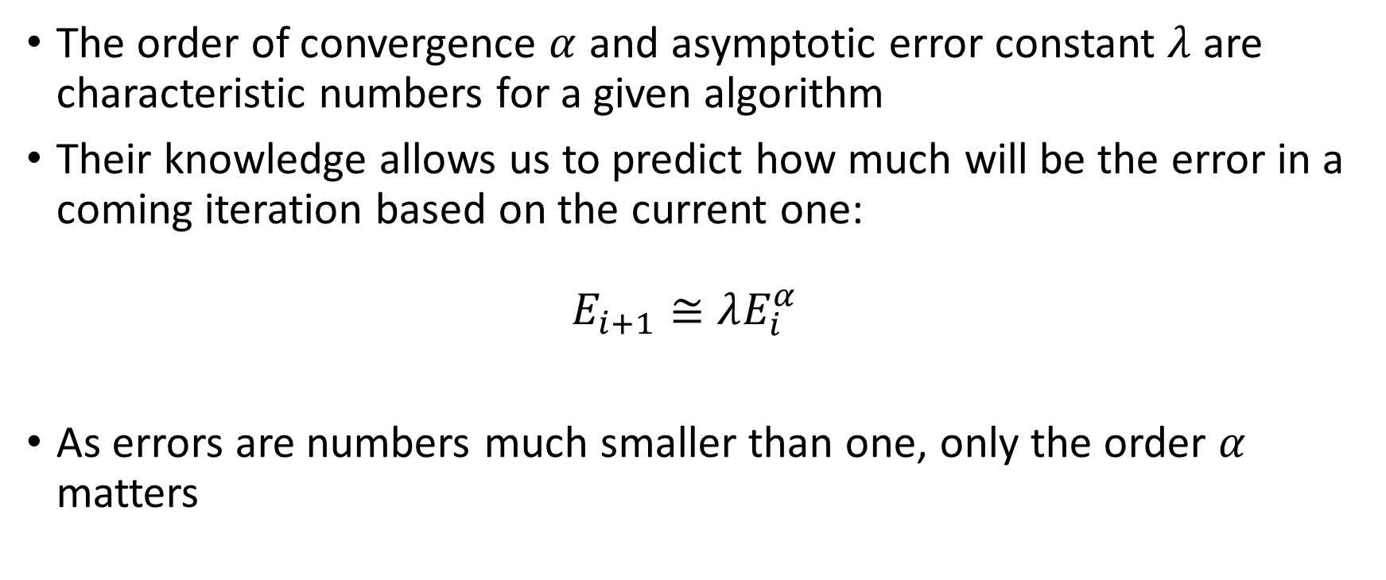
Order of convergence – A characteristics of the Algorithm
The order of convergence $α$ and asymptotic error constant $λ$ are characteristic numbers for a given algorithm
Their knowledge allows us to predict how much will be the error in a coming iteration based on the current one: $E_{i+1}≅λE_{i}^{α}$
As errors are numbers much smaller than one, only the order $α$ matters
Notes:
In fact each algorithm has a given order of convergence $α$ which is independent on the specific equation we try to solve.
The situation is slightly different for the asymptotic error constant $λ.$ This constant is often independent on the equation we solve, but for some algorithms will depend on the given problem we try to solve. But, as we have seen in our previous example, only the order of convergence matters, and consequently the knowledge of$λ$ is not very important.
Knowing the order of convergence allows us to predict the error in the following iteration.
Let us repeat once more that as errors are small number, what really matters is the value of alpha.

Slide 12
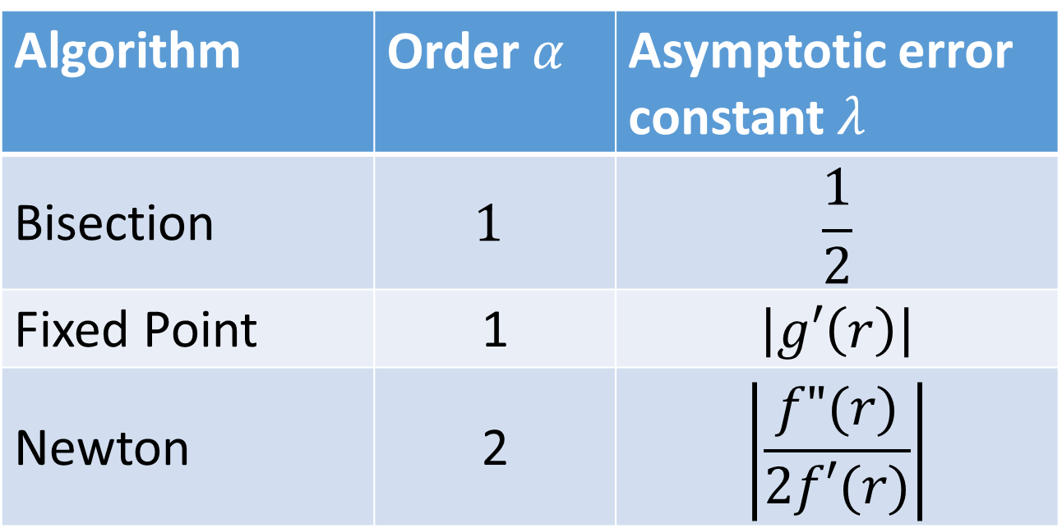
Order of convergence of some algorithms
Algorithm | Order $α$ | Asymptotic error constant $λ$
Bisection | $$1$$ | $$\frac{1}{2}$$
Fixed Point | 1 | $$\left|g′\left(r\right)\right|$$
Newton | 2 | $$\left|\frac{f"(r)}{2f′(r)}\right|$$
}
Linear
convergence
}
Quadratic
convergence
Notes:
The table you see summarizes for three algorithms their order of convergence.
As we have discussed, the bisection algorithm is of order one.
The fixed point iteration method is as well of order one.
This behaviour is often referred to as linearly convergent algorithms. Such algorithms are very slow as in each iterations the error is essentially the same order of magnitude than in the previous one, only slightly reduced by the error constant lambda.
Newton’s algorithm is of order two. This is referred to as a quadratic convergence.
Quadratic algorithms are very fast algorithms. The specific value of lambda is not really relevant as we have already realised in our example.
In the coming lecture we are going to see more examples on how we can apply the elements of this table.
Once finished this lecture I recommend you to go back to the lecture on error control of the bisection algorithm which you followed previously. Take some time to compare how we have estimated the number of iterations needed to reach a given tolerance with the concept of order of convergence you have learned in the present lecture.

Slide 13
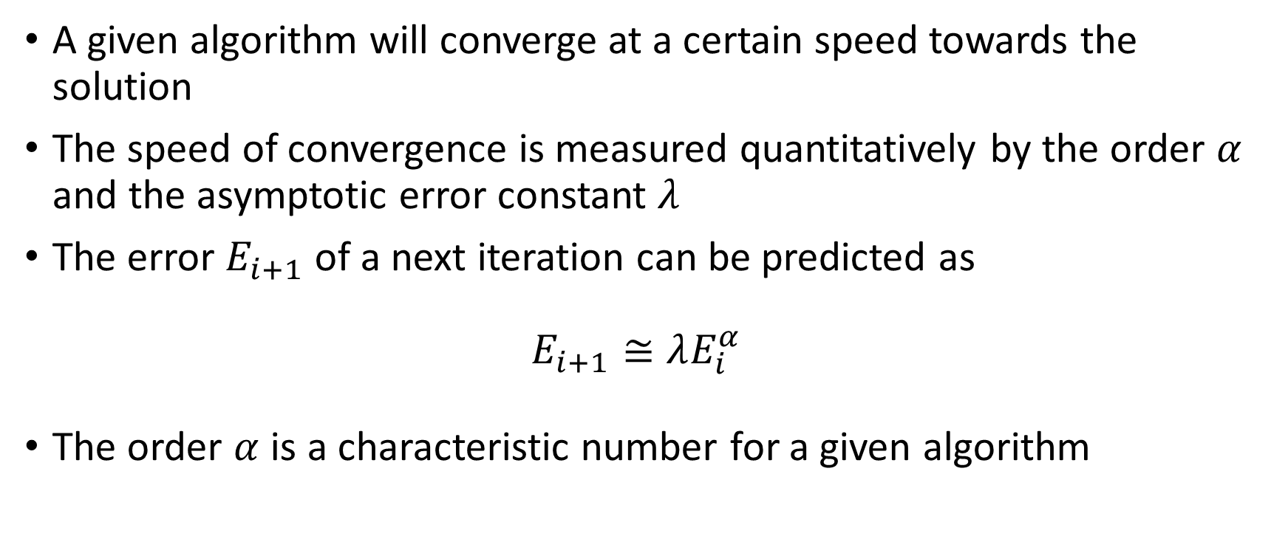
Summary
A given algorithm will converge at a certain speed towards the solution
The speed of convergence is measured quantitatively by the order $α$ and the asymptotic error constant $λ$
The error $E_{i+1}$ of a next iteration can be predicted as $E_{i+1}≅λE_{i}^{α}$
The order $α$ is a characteristic number for a given algorithm
Notes:
Let us summarize the key findings
A given algorithm will converge at a certain speed towards the solution
The speed of convergence is measured quantitatively by the order $α$ and the asymptotic error constant $λ$
The error $E_{i+1}$ of a next iteration can be predicted as$E_{i+1}≅λE_{i}^{α}$
The order $α$ is a characteristic number for a given algorithm

